Slide 1

Introduction to Software Business Product management
Week 2 Day 1
Led by: Emily Crose
for
Oakland University

Slide 2


Previous session questions

Slide 3
Terms to listen for
Cache
A small portion of RAM set aside for temporary storage for frequently accessed data
Process Register
A quickly accessible location available to a computer processor
Heap & Stack
Memory management methods

Slide 4
Applications & Operating Systems
Notes:
In past classes, we’ve talked about where software and operating systems overlap, but only in broad strokes. Today, we’re going to get into this in greater detail.

Slide 5
Operating Systems Overview

Slide 6
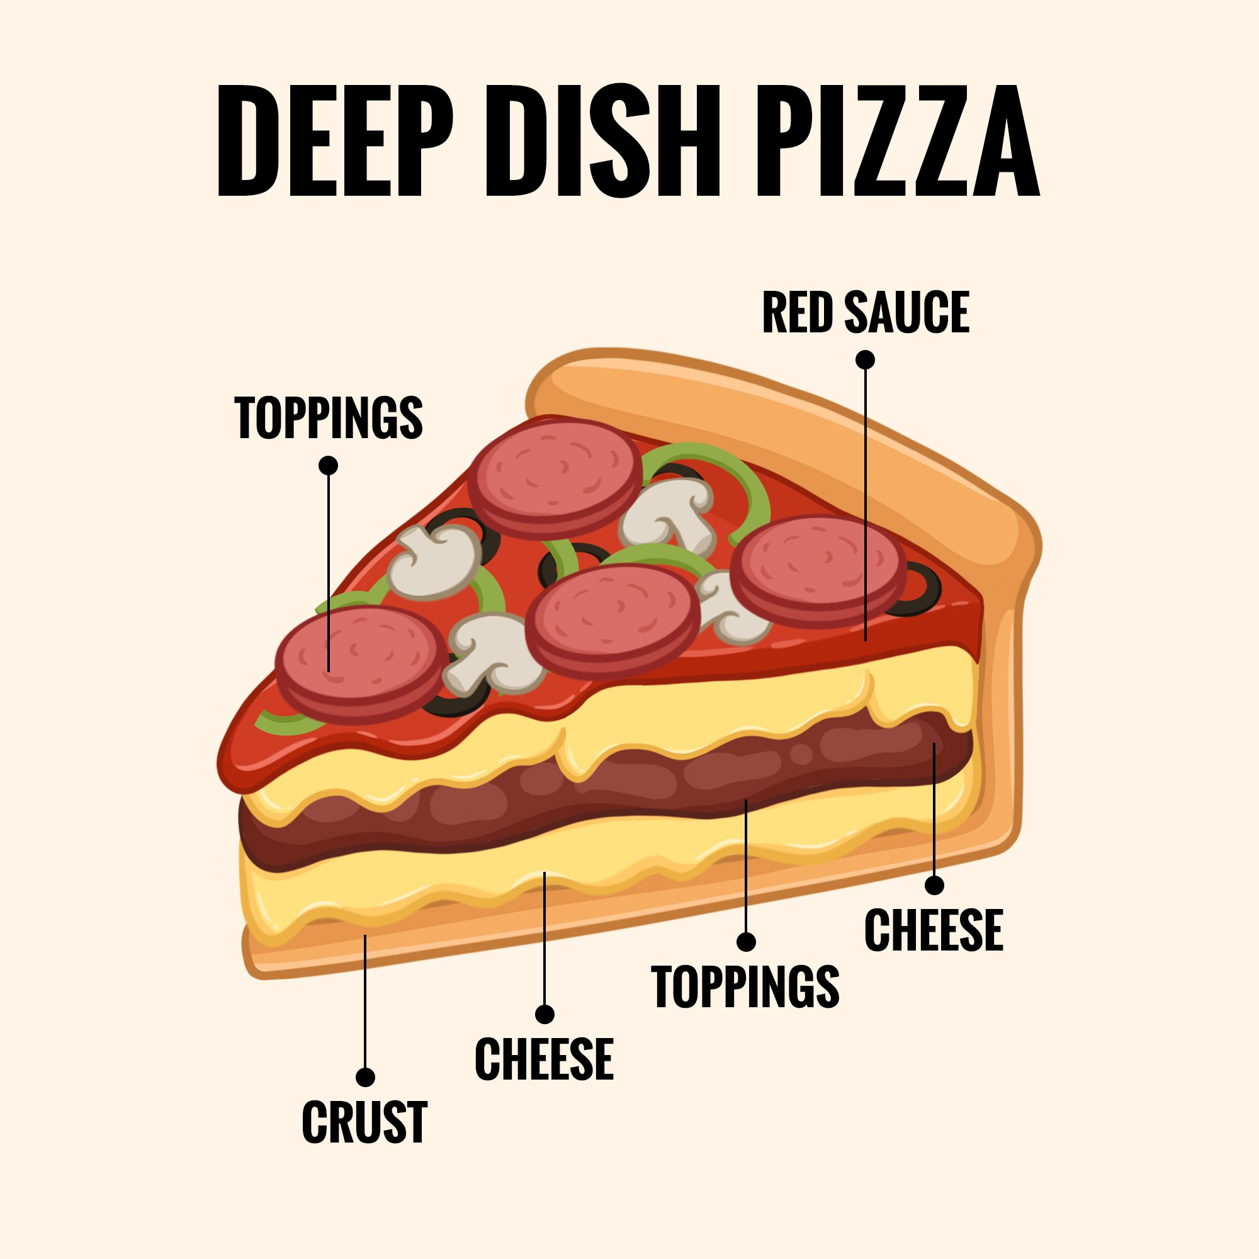
Notes:
When I think of software development and operating systems, I think of pizza. A deep dish pizza in particular has many layers to it. Of course you have the crust. In a deep dish pizza, controversially, you have a layer of cheese, a layer of toppings, another layer of cheese and a layer of sauce and toppings. In programming, the first few layers is the operating system. It’s on top of this crust of operating system that we build our applications to run on.

Slide 7

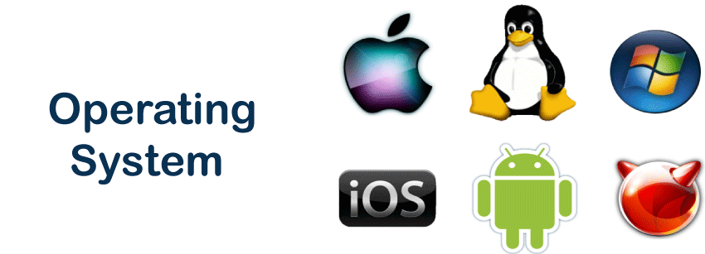
Well-known Operating systems

Slide 8
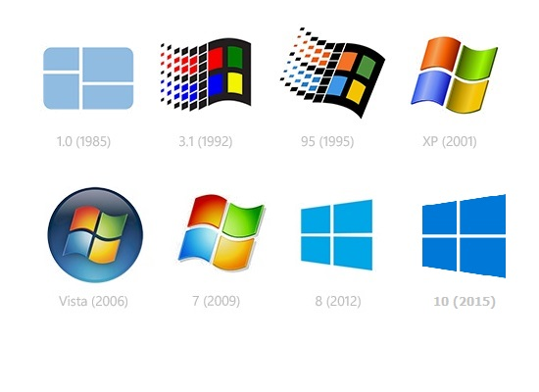
Old & Out of support windows versions

Slide 9
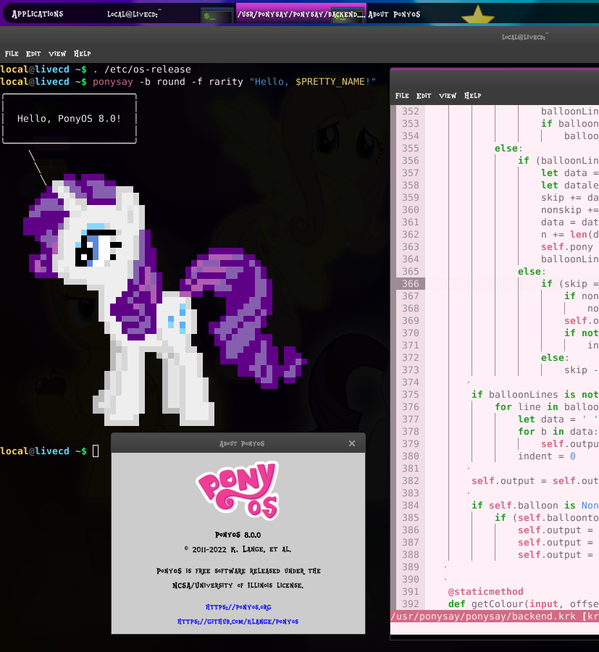

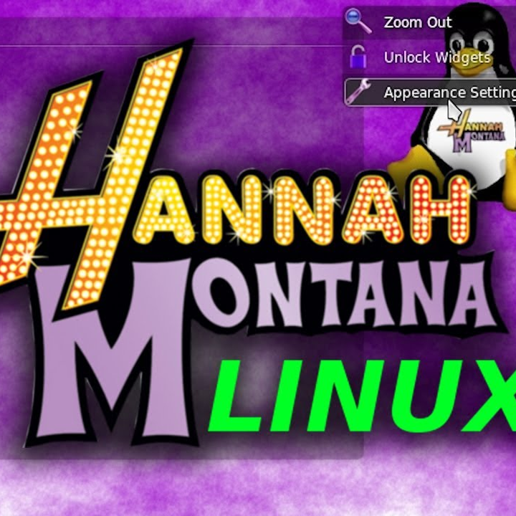

Funny Linux variants
Notes:
Qubes, TempleOS, Hannah Montana Linux, PonyOS

Slide 10
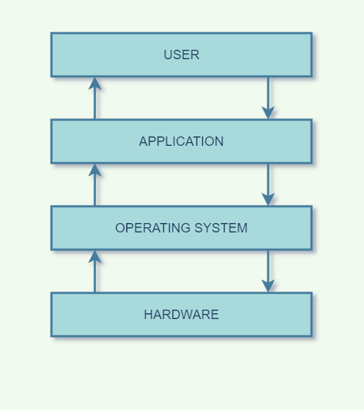
Operating Systems vs Applications

Slide 11
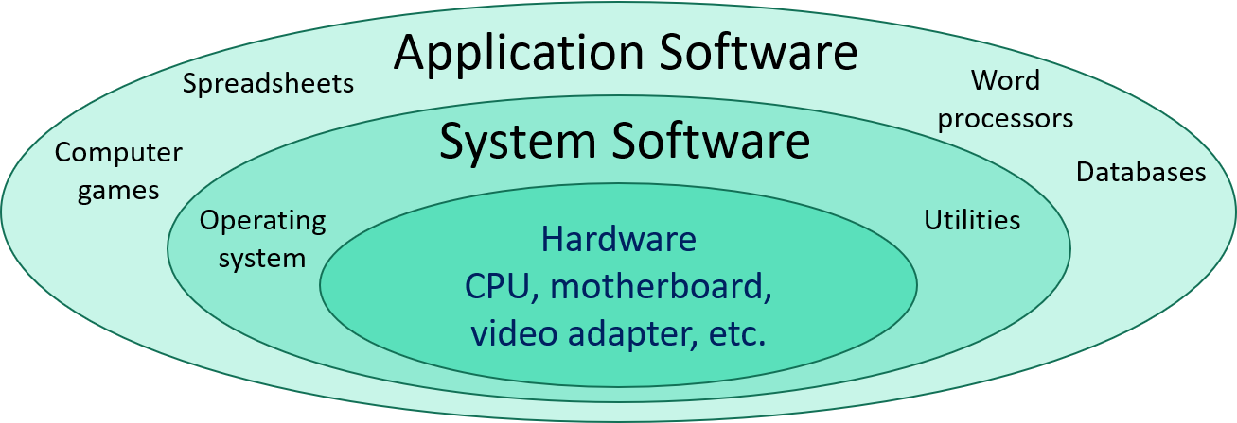
Notes:
What about you all? Where do you come from? What kinds of backgrounds do you have?

Slide 12
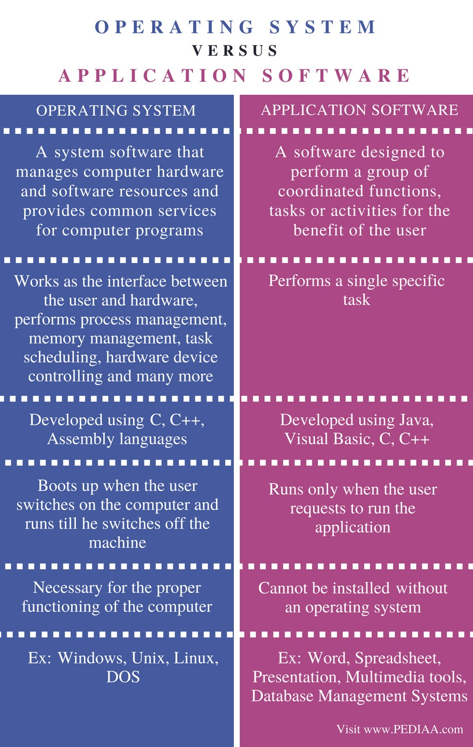
OS & app differences

Slide 13

Permissions

Slide 14
What do permissions do?
Allow read, write, and execute permissions for files and folders
Can be changed with those who have rights to change file and folder permissions levels
Can be customized for users, groups, and “others”

Slide 15
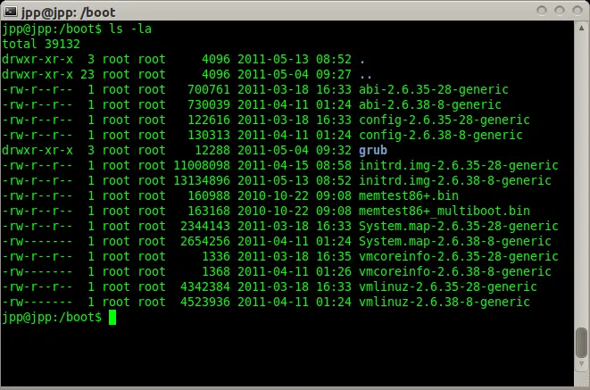
Linux permissions in practice

Slide 16
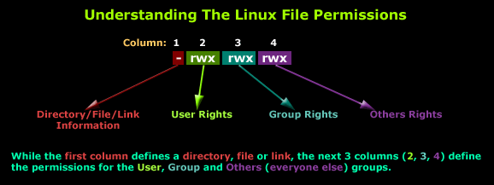
Understanding permissions

Slide 17
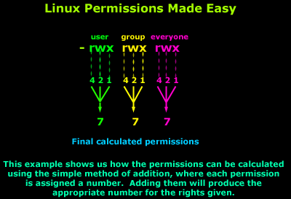
Linux permissions

Slide 18
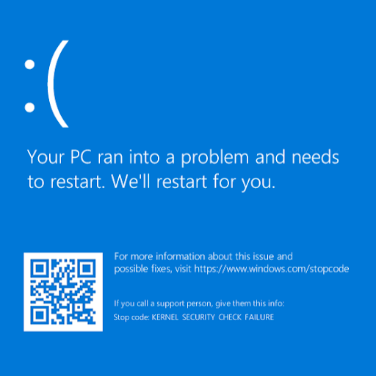
Notes:
Does this screen look familiar to anyone? Who has seen this before?

Slide 19
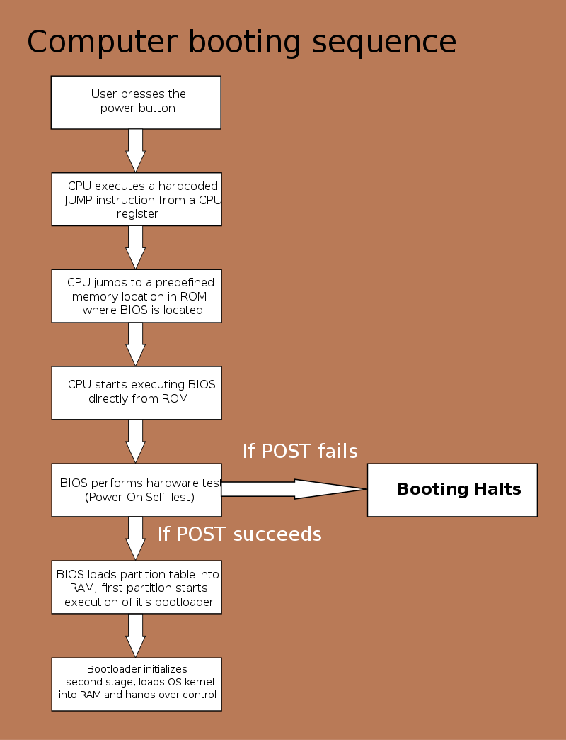
Power-on self-test (POST)

Slide 20
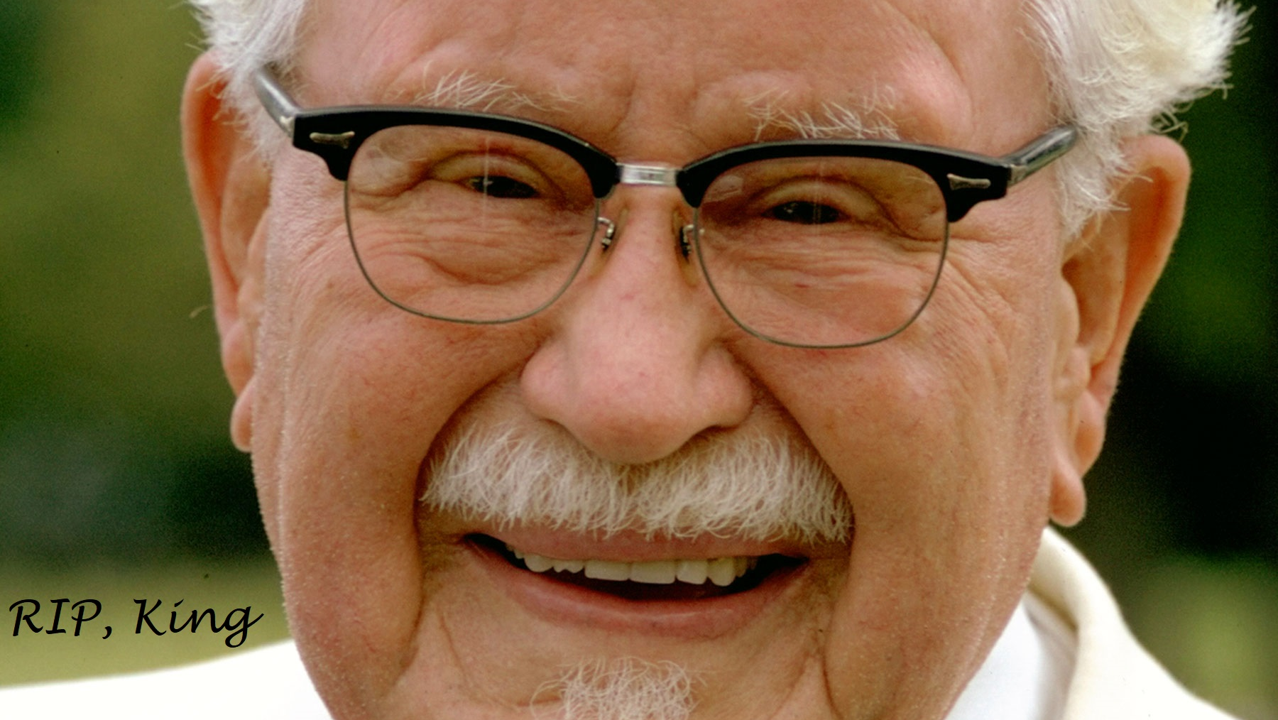
The kernel

Slide 21
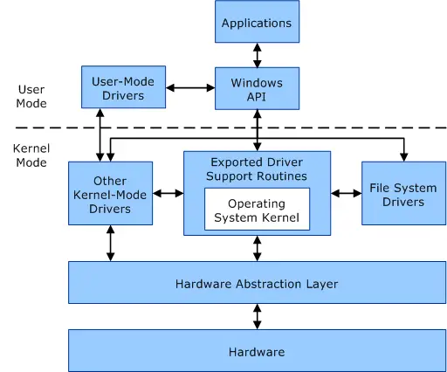
Notes:
Let’s take a

Slide 22
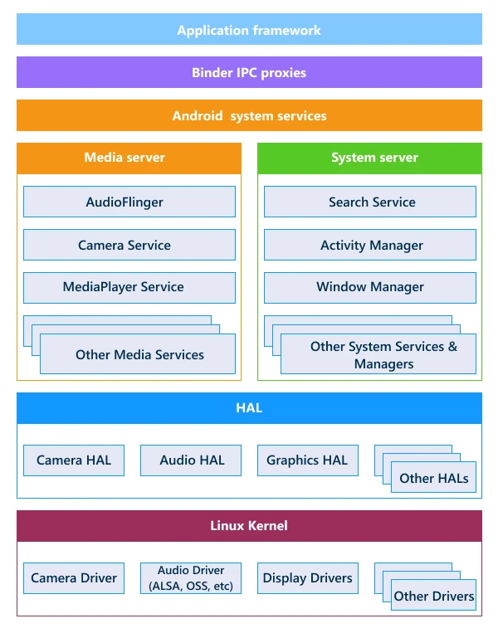

Slide 23
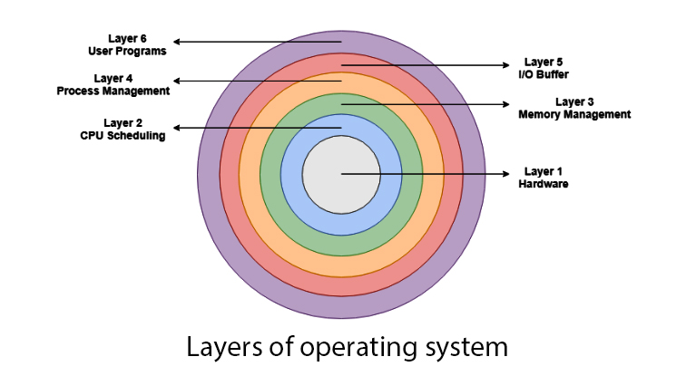

Slide 24
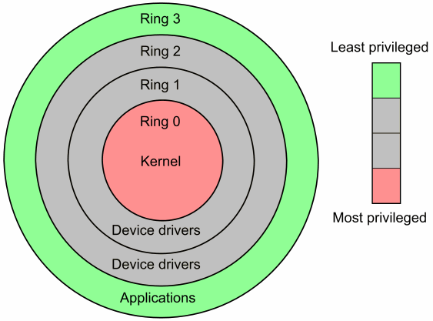

Slide 25
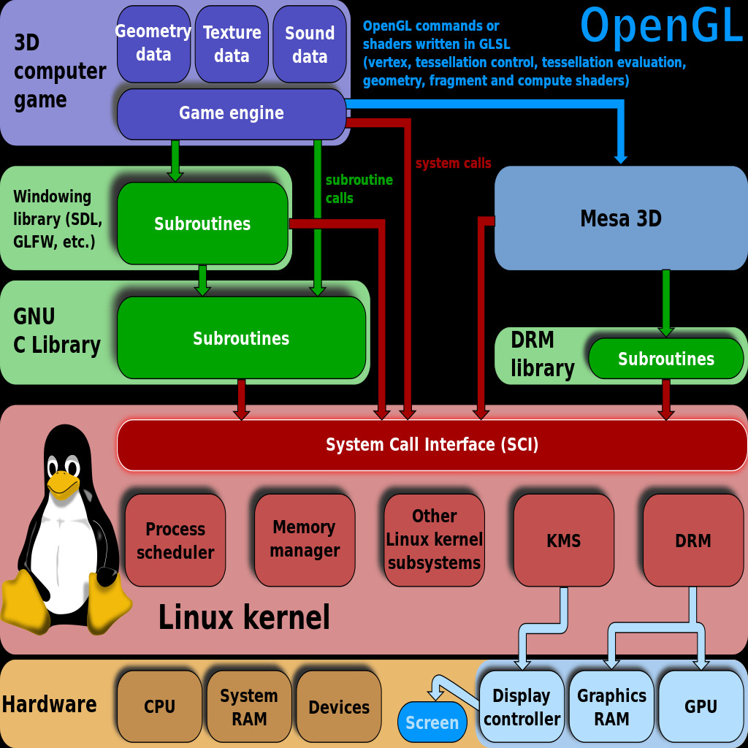
Kernel operation
Notes:
Let’s take a look at a complex diagram of

Slide 26
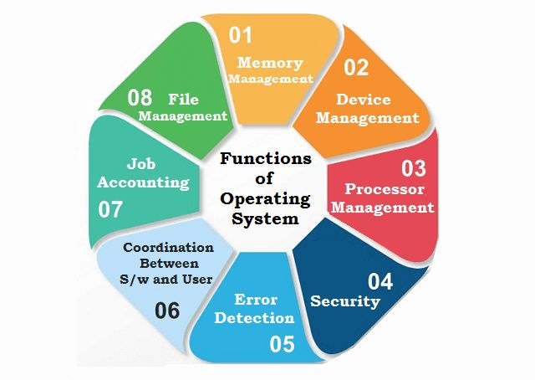
Operating system Support

Slide 27

10 minute break

Slide 28

Applications

Slide 29
Types of Applications
Mobile applications
Desktop applications
Embedded applications
Web applications

Slide 30
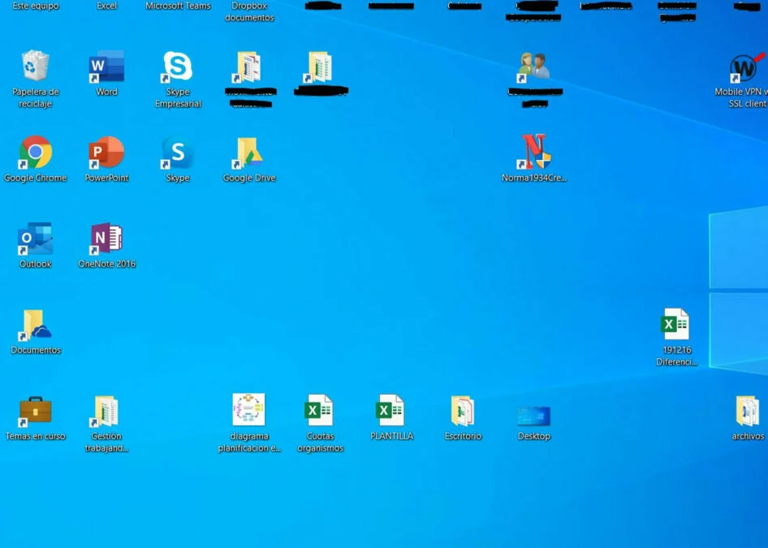
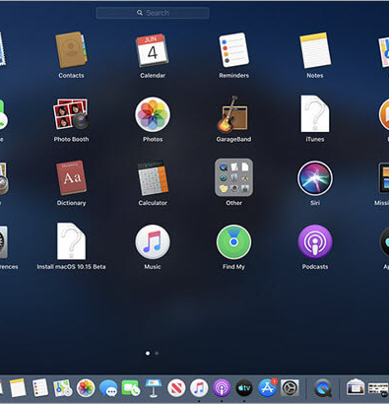
Desktop Applications

Slide 31
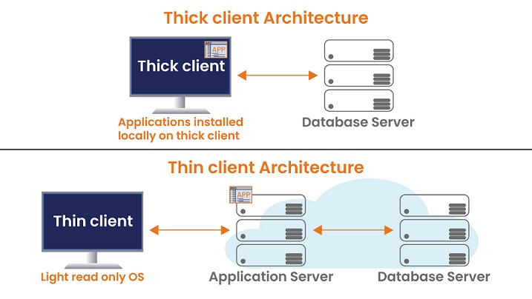
“thin” client vs “thick” client
Notes:
We should touch briefly on thin clients and thick clients from an application concept. The server-side concept is more of an architecture question that we will get more into starting next week.

Slide 32
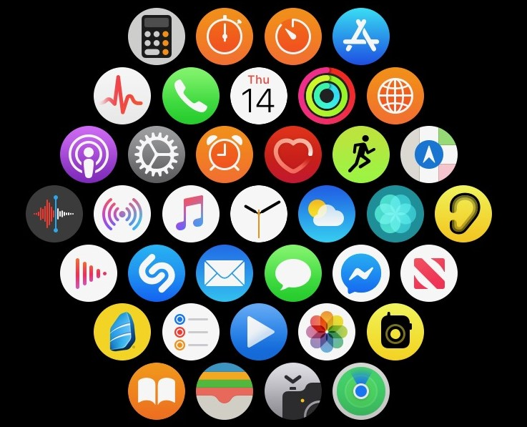
Mobile Applications

Slide 33
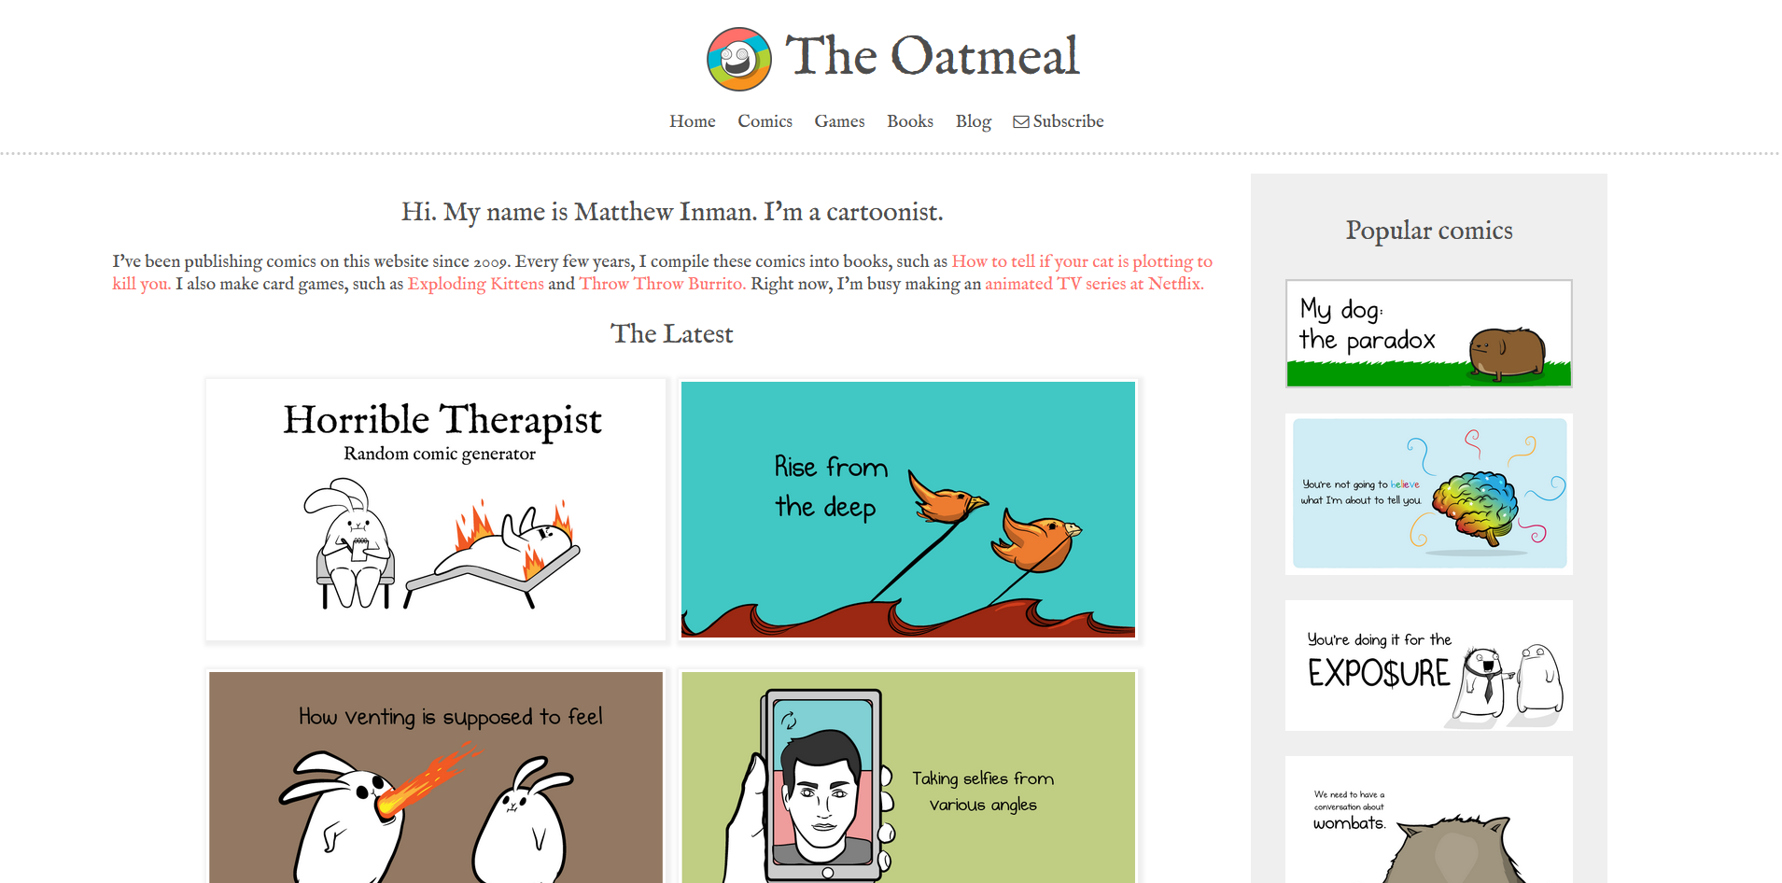
website
Notes:
We all know what a website is and how they work. Websites are, for the most part, a one-way transmission of information. We ask for information, and websites provide it. We may, to some extent, be able to interact with a website, for example some websites let us log in to get information, but this functionality does not change the fact that a website is still, for the most part, a one-way exchange of information.

Slide 34
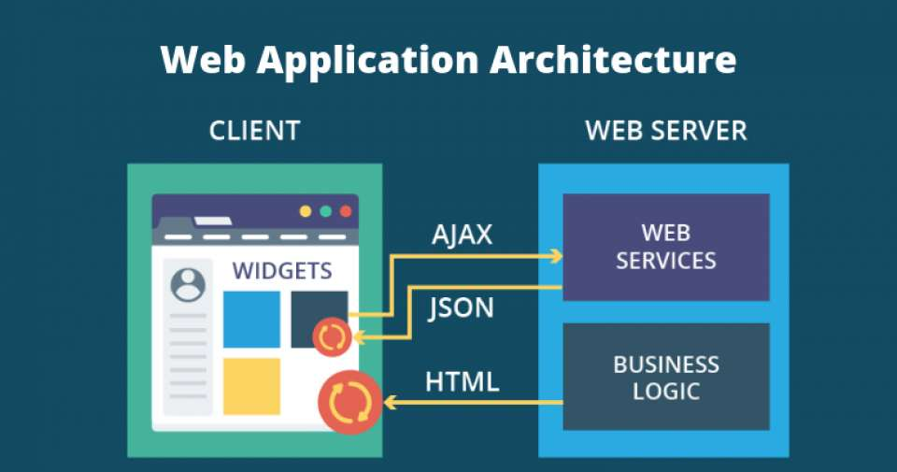
Web Applications

Slide 35
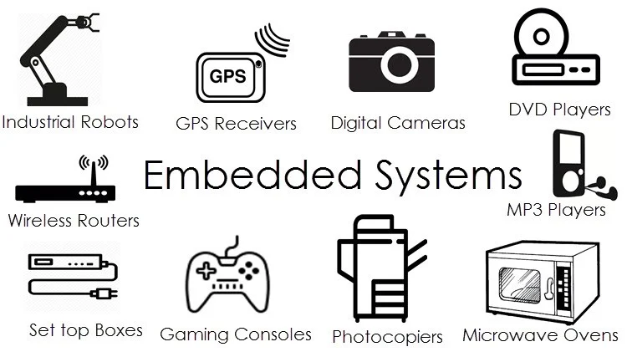
Embedded software & Systems

Slide 36
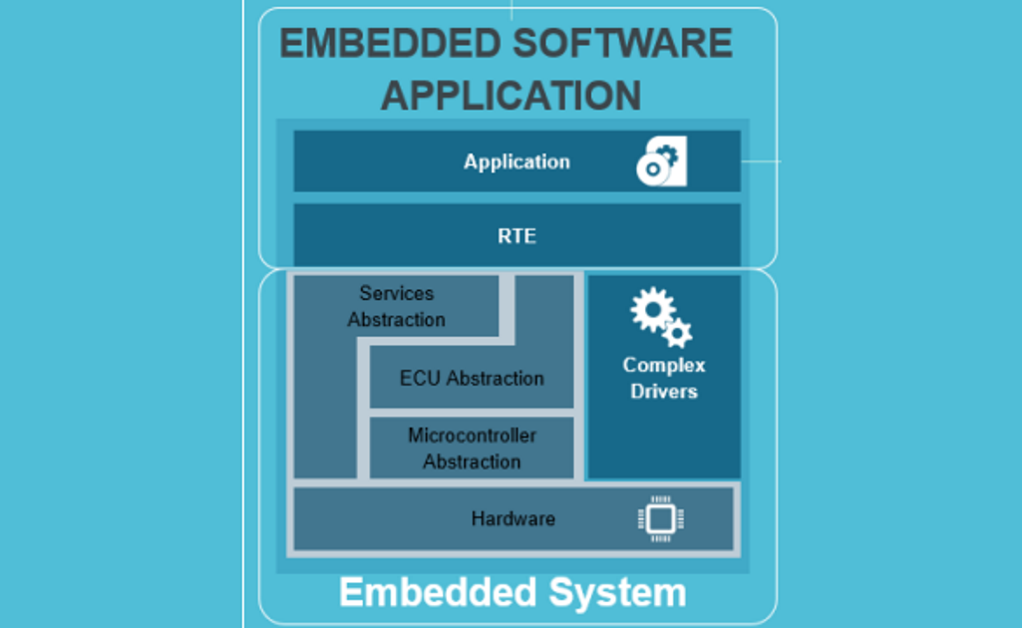
Notes:
RTE = Runtime Environment. This is the environment in which a program executes. This is typically a special purpose-built environment that is optimized for the hardware the system runs on.

Slide 37
Where does Iot fit?
What do we know about IoT?
Inside of consumer electronics
Embedded applications?
Can IoT be more than one category?

Slide 38
10 minute break

Slide 39

Binary

Slide 40
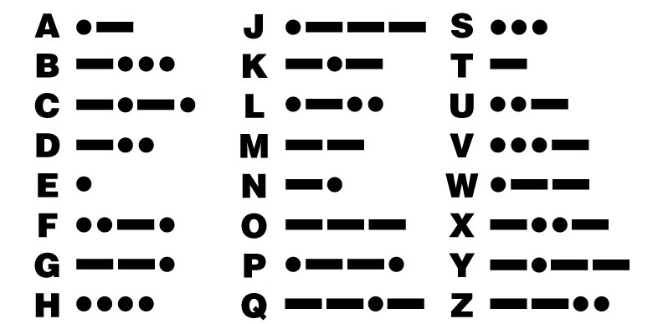
Notes:
Most of you will probably recognize this, does anyone want to say what it is?

Slide 41
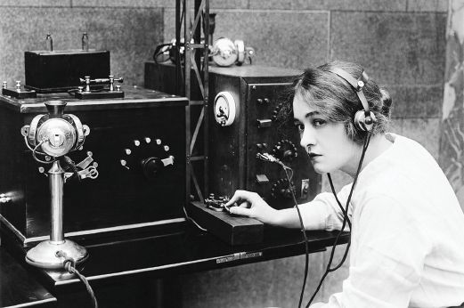

Binary Communication

Slide 42
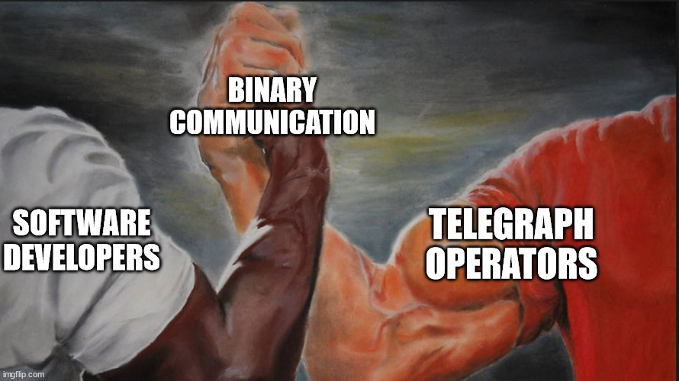

Slide 43
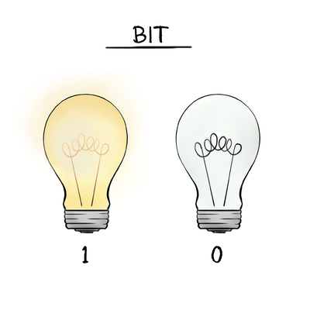

Slide 44
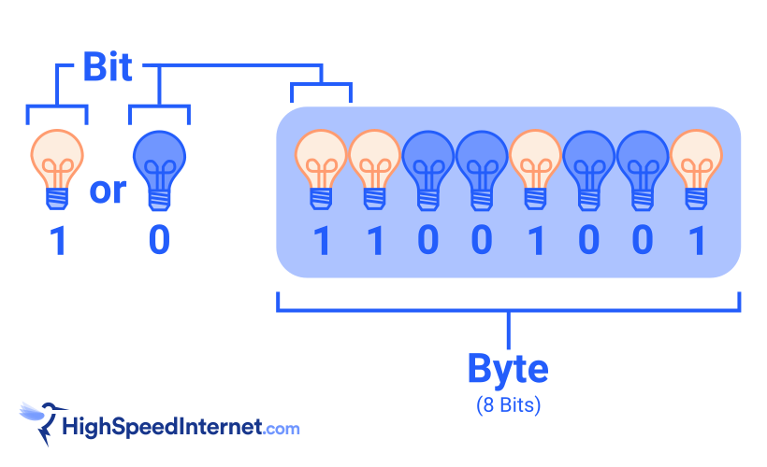
Bits & bytes

Slide 45
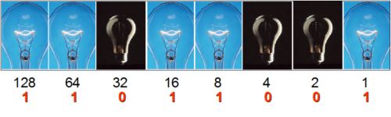

Slide 46
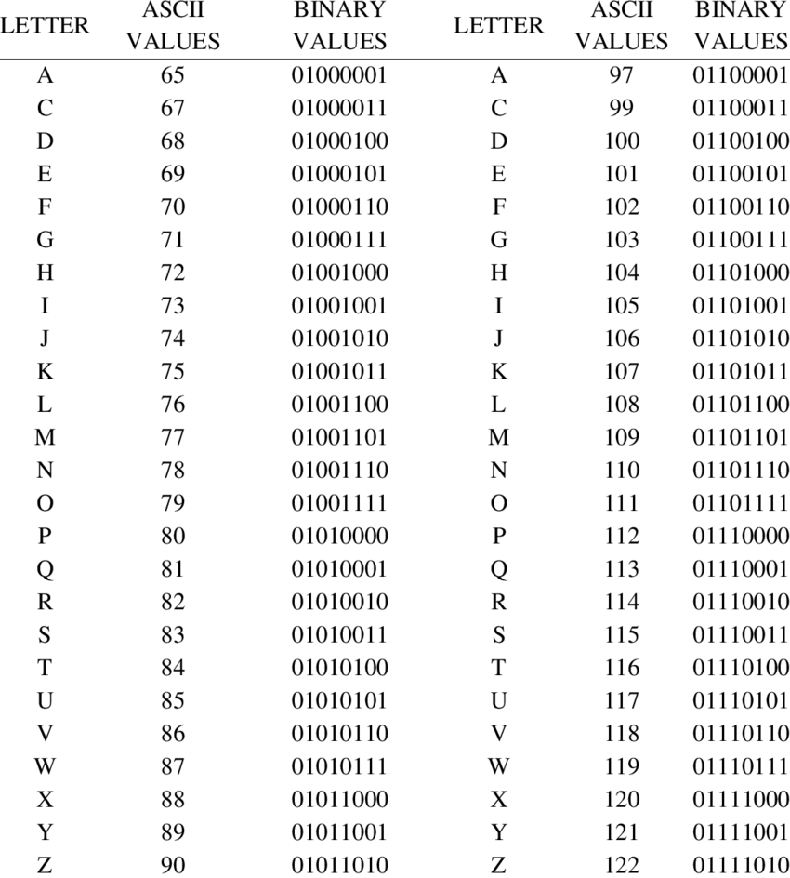

Slide 47
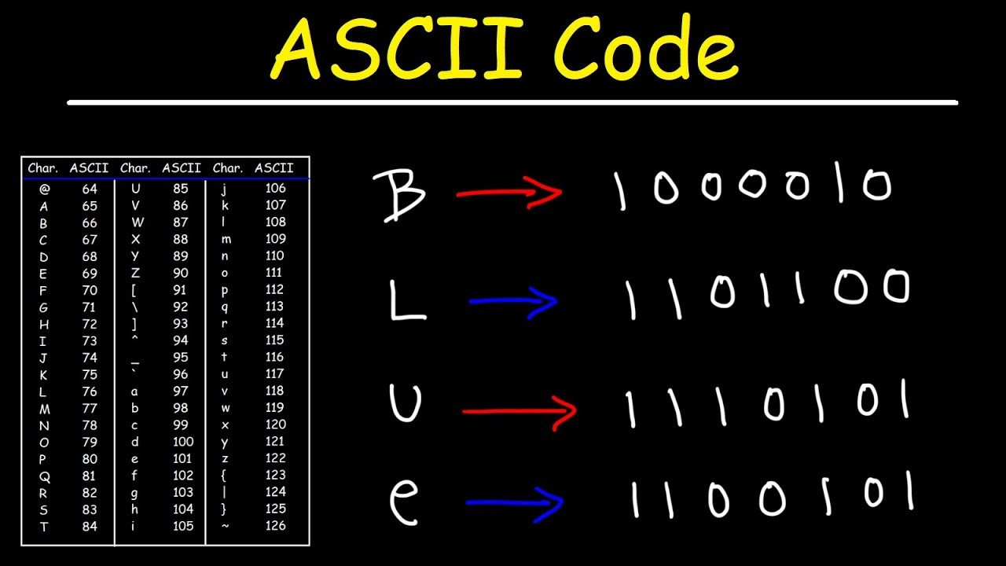

Slide 48
Other base formats
Binary – Base 2 numbering (1, 0)
Octal – Base 8 numbering (0,1,2,3,4,5,6,7,8,9)
Decimal – base 10 communication (0-9)
Hexadecimal – base 16 (0-9, A-F)

Slide 49
Fun with translations!
https://gchq.github.io/CyberChef/
Notes:
https://gchq.github.io/CyberChef/#recipe=From_Morse_Code('Space','Line%20feed')To_Binary('Space',8)To_Decimal('Space',false)&input=Li0tLg

Slide 50

Memory Mismanagement
Notes:
Memory and memory management are important concepts for software development. When writing software, you will need to pay attention to

Slide 51
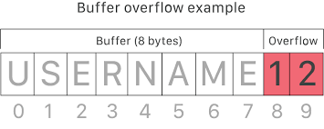
Buffer overflow

Slide 52

CPU Architecture

Slide 53
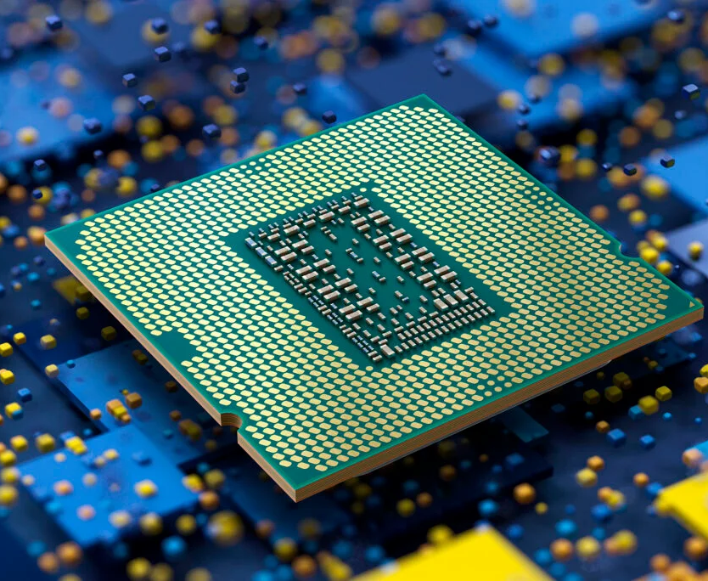
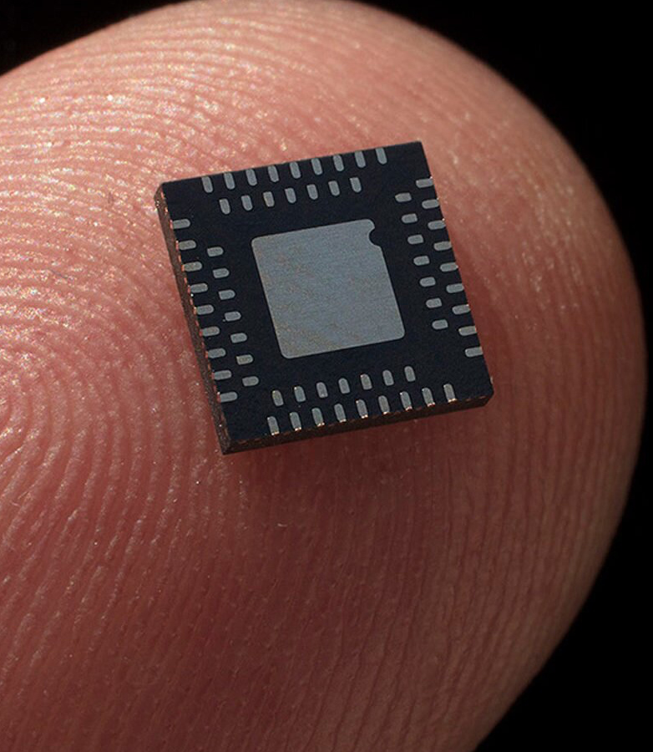

Slide 54
Processor classifications
Architecture
Processed bits
Design
Registers

Slide 55
Common CPU Architectures
X86
Desktop PCs
Most Intel chips are built on this
More cores
Arm/A32
Small consumer electronic devices
Arm/A64
New Macbook Pro M1 & M2
RISC-V
Notes:
RISC-V represents a big jump into the future. While most CPUs you will run into today process at 64 bits on the high end, RISC-V processes at 128 bits

Slide 56
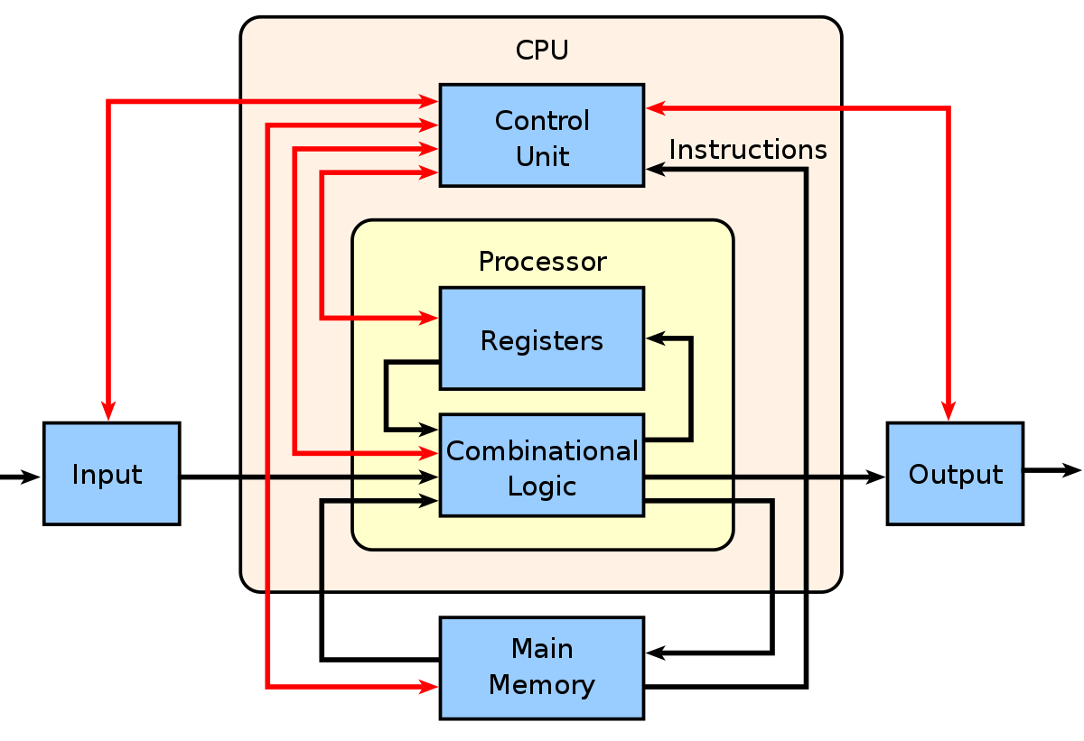
How processing works

Slide 57

Session review

Slide 58

Question or clarifications?

Slide 59

Preview next session

Slide 60
See you next time!

